Slide 1
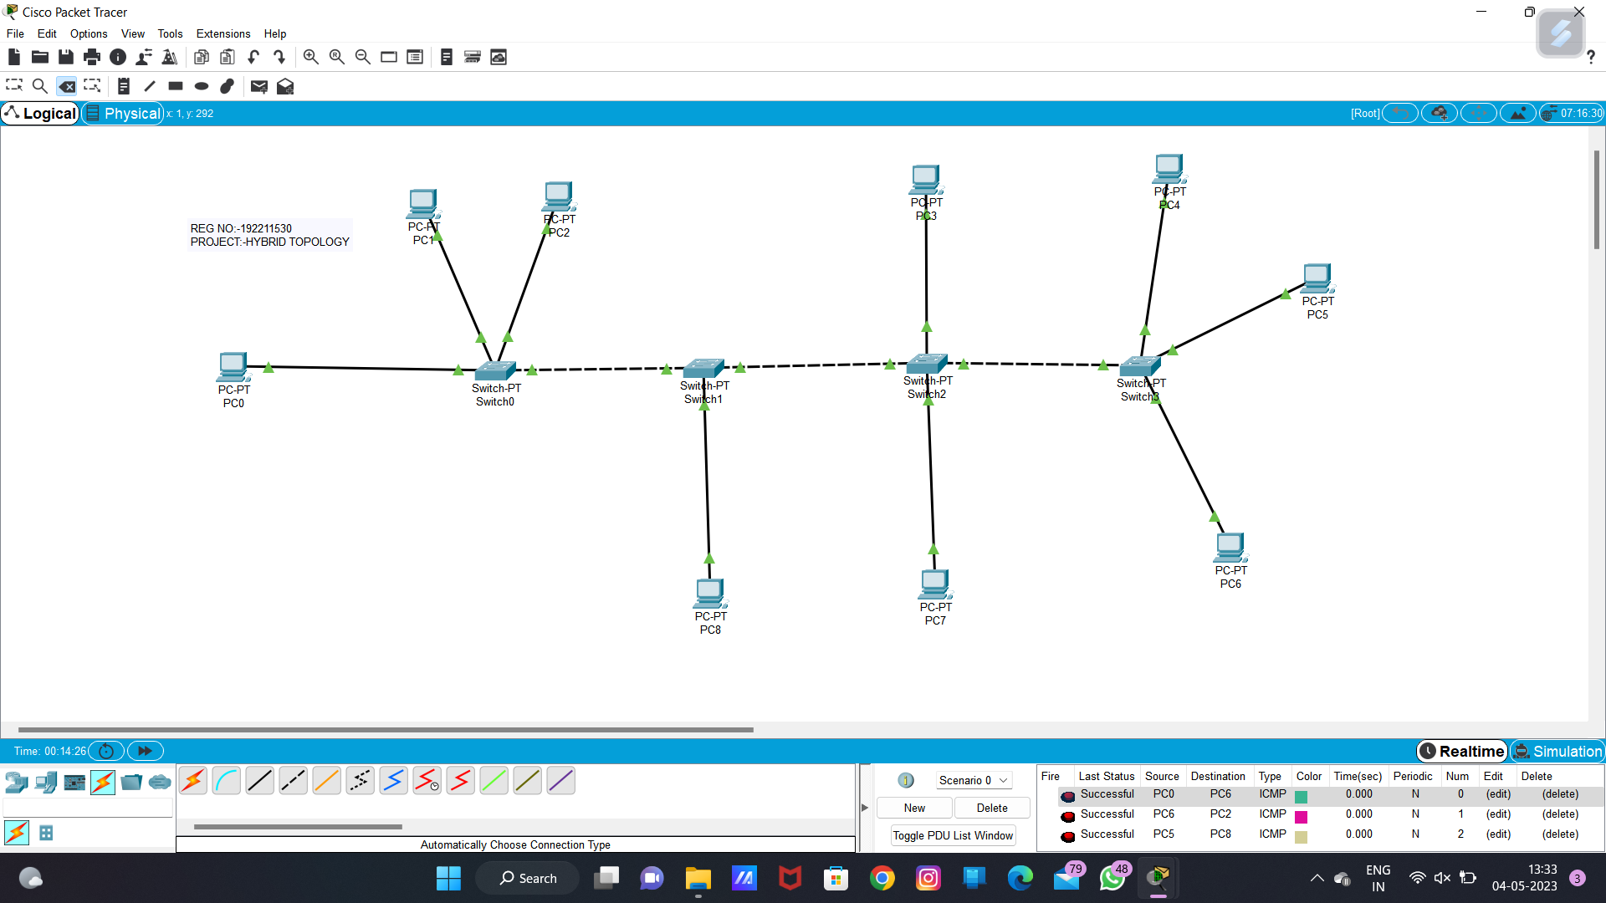

192211527
Hybrid Topology

Slide 2
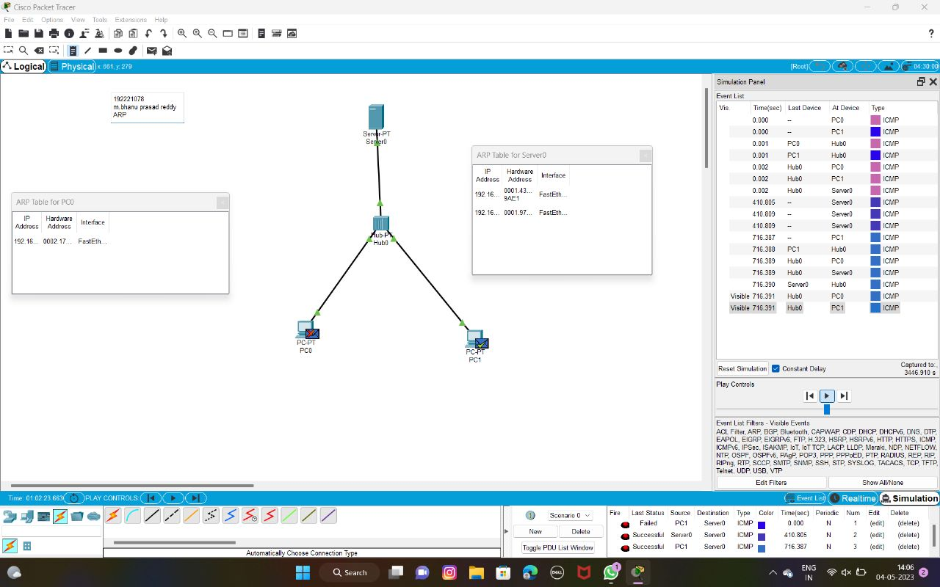
192211527
ARP

Slide 3
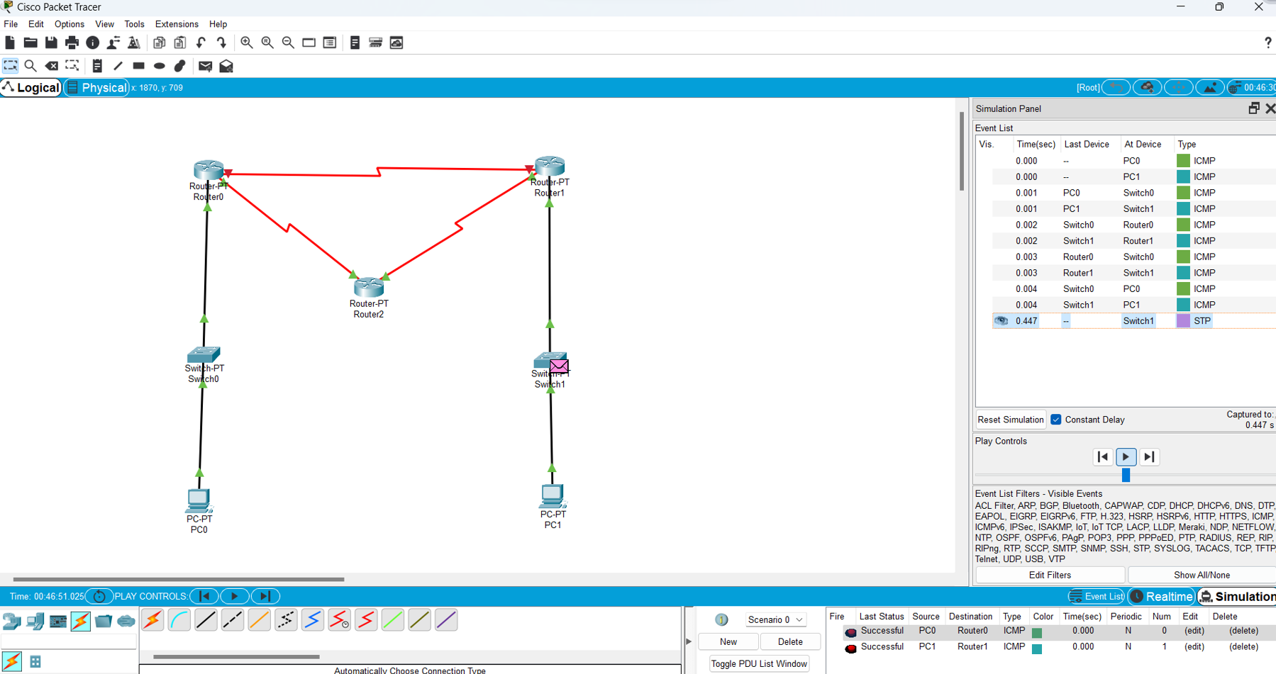
192211527
Dynamic Routing

Slide 4
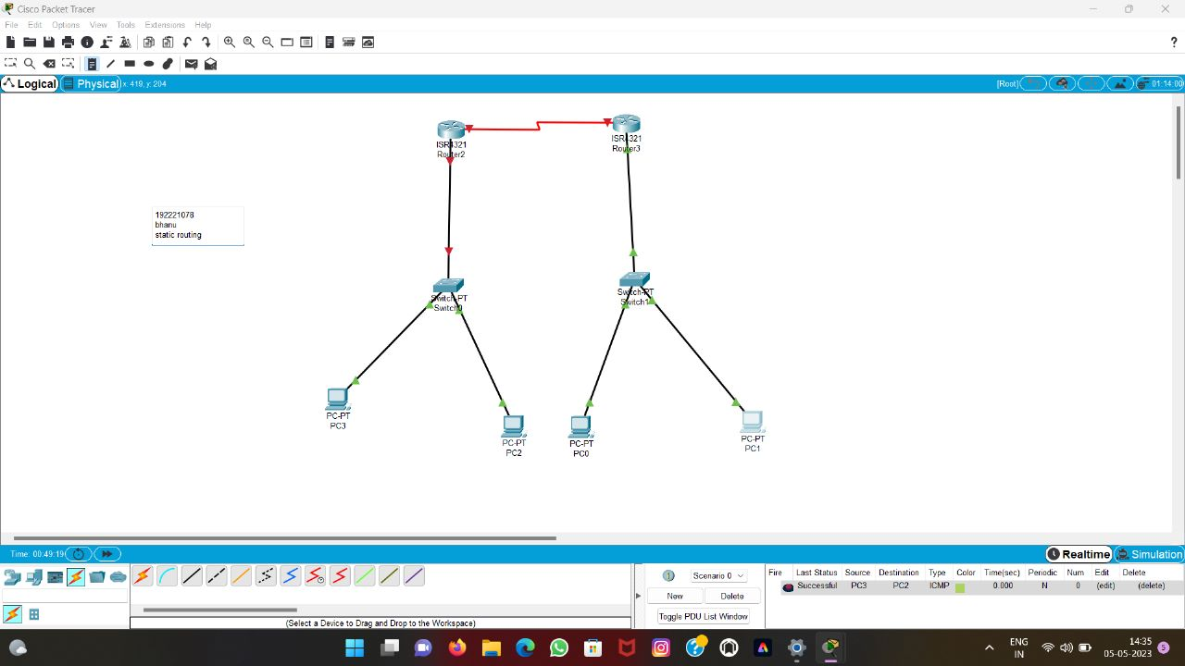
192211527
Static Routing

